Slide 1
Workshop on Drone
Presented by:
Keshav Kumar Roy
Anil Mondedla

Slide 2
CONTENT
Assembly
Specifications of each components
Interconnection diagram between each components
Video tutorial for Assembling the drone
Configuration
Installing mission planner software.
Connection with the controller
Calibration of various sensors of the controller
Testing
Testing Videos
Question/Answer session

Slide 3
Main Components
Description | Make | Model
Frame(quad-copter 4 axis) | - | F450
Motor (1000Kv) | - | A2212/13T
ESC (30Amp) | Simonk | 30A
APM Controller (2.8) | ArduPilot | APM 2.8
Transmitters and Receiver () | Flysky | Fs-i6 2.4Ghz
Duracell Batteries for Transmitter | Duracell | Ultra (Alkaline AA)
GPS | Ublox | NEO 5pin
Battery (2200mAh 3S, ,11V) | Shang yi | B3 - 2200 mAH
Battery Chargers (B3) | imaxRC | B3 pro
Propellers pairs (CW and ACW) | - | (10*4.5inch)

Slide 4
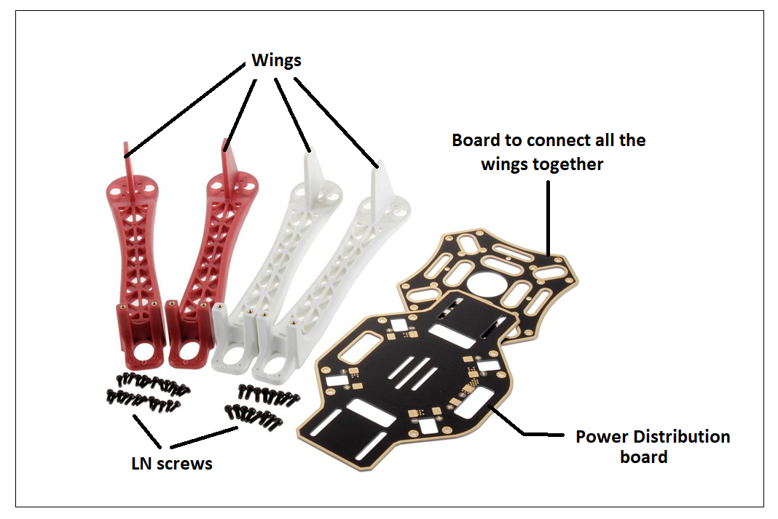
Frame (quad-coptor 4 axis) - F450

Slide 5
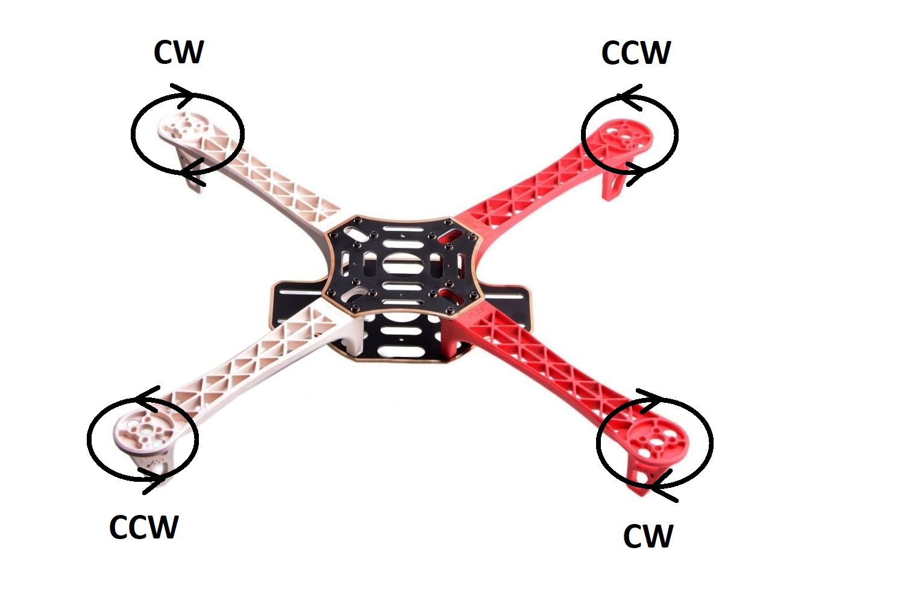
Directions of motors w.r.t the frames

Slide 6
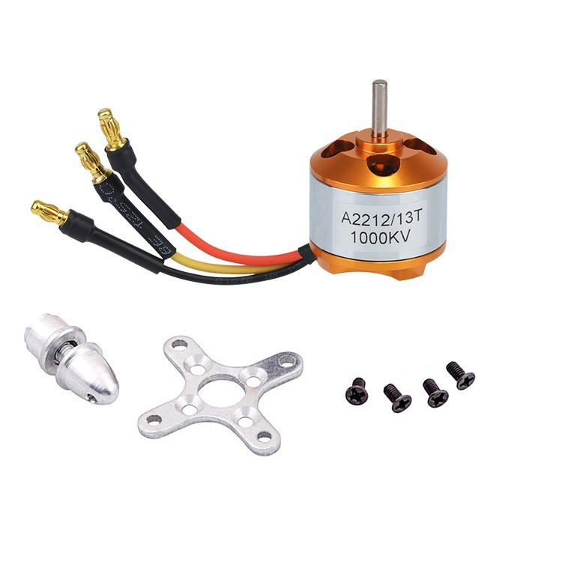
MOTORS (A2212/13T)
kV rating : 1000 kV
Operating voltage : 12V
Idle Current: 0.5 A
Motor Dimensions: 27.5 x 30mm
Shaft Diameter: 934;3.17mm
Shaft diameter : 3.175mm.
Weight: 47 g

Slide 7
Electronic Speed Controller (Simonk 30A)
Output:
30A continuous;
40Amps for 10 seconds
Input voltage: 2-4 cells Lithium Polymer
BEC : 5V, 3Amp for external receiver and servos
Max Speed:
2 Pole: 210,000rpm;
6 Pole: 70,000rpm;
12 Pole: 35,000rpm
Weight: 32gms
Size: 55mm x 26mm x 13mm

Slide 8
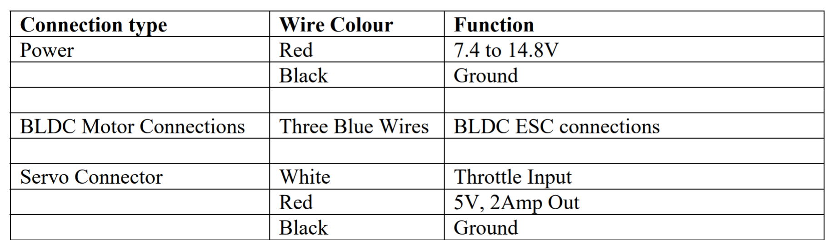
Connections of ESC

Slide 9
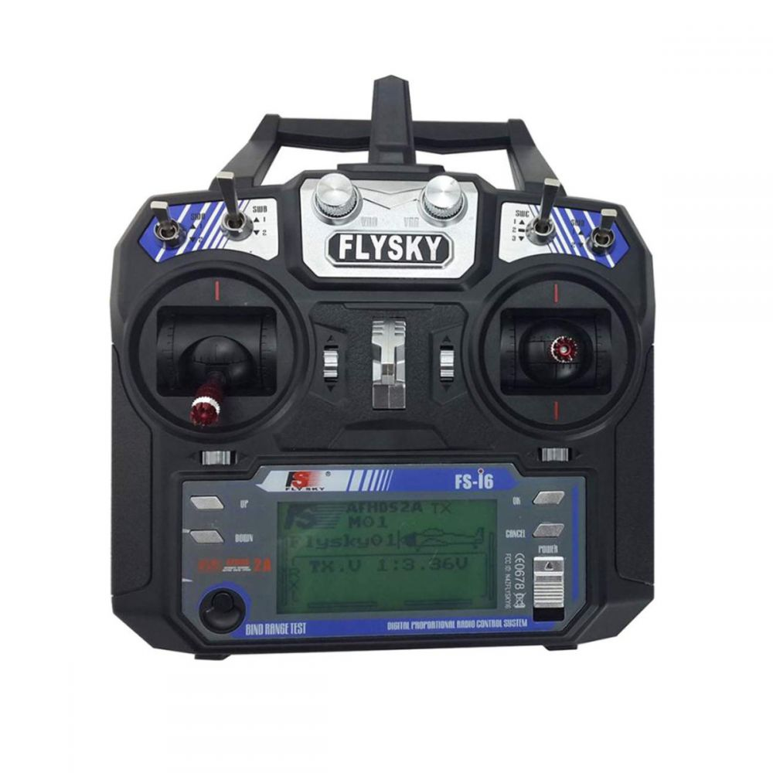
TRANSMITTER (Fly sky fs-i6 )
Model type : Quadcopter
RF range : 2.408 - 2.475GHz
Bandwidth : 500 KHz
Bands : 135
RF power : Less than 20 dBm
Protocol : AFHDS 2A
Modulation type : GFSK
PS2/USB Port : Yes (Micro-USB)
Power input : 6V DC 1.4AA*4
Weight : 392g
Size : 174 x 89 x 190 mm
Color : Black

Slide 10
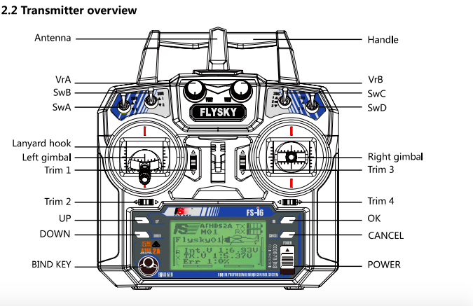

Slide 11
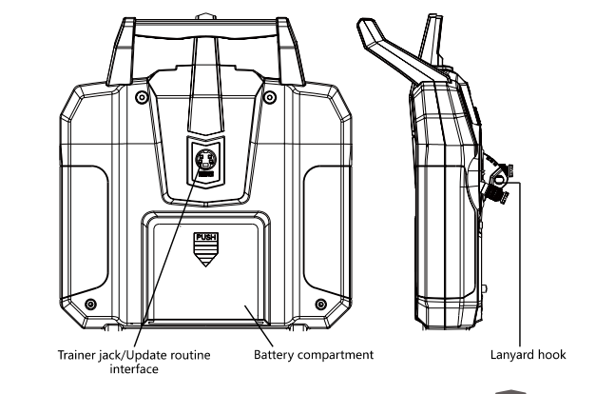

Slide 12
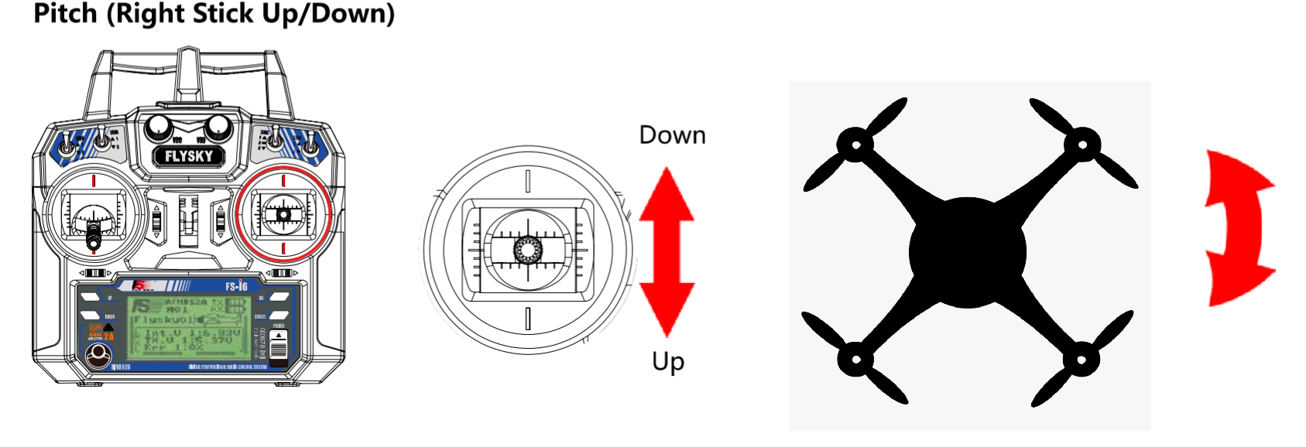
FUNCTION OF EACH STICK

Slide 13
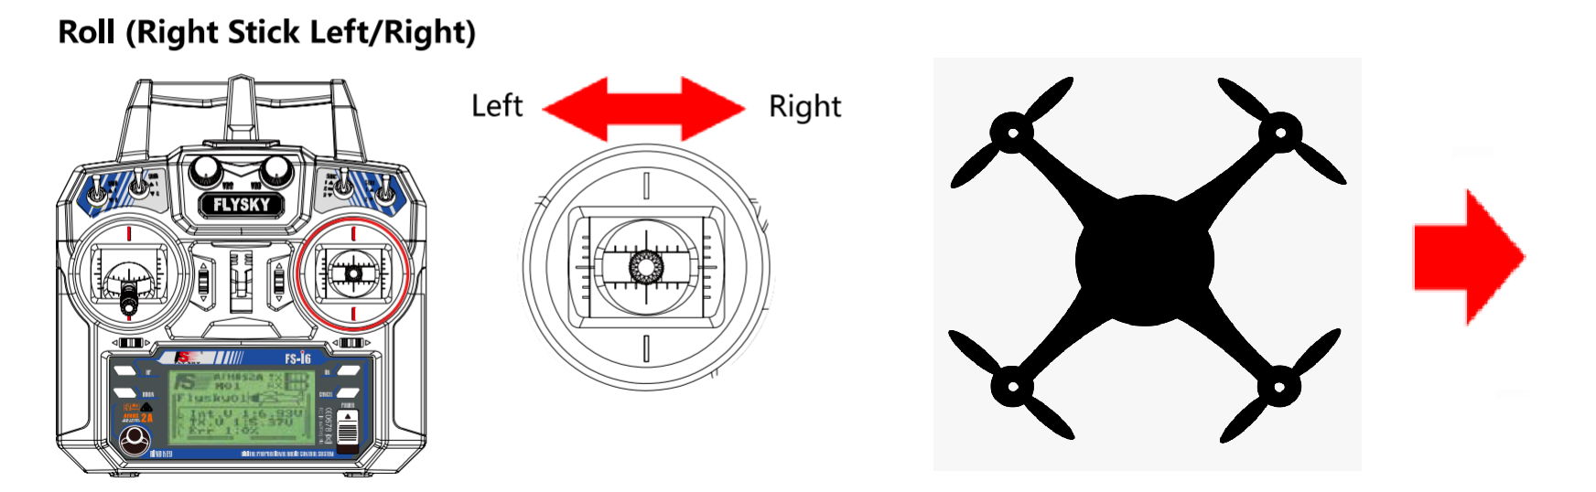
FUNCTION OF EACH STICK

Slide 14
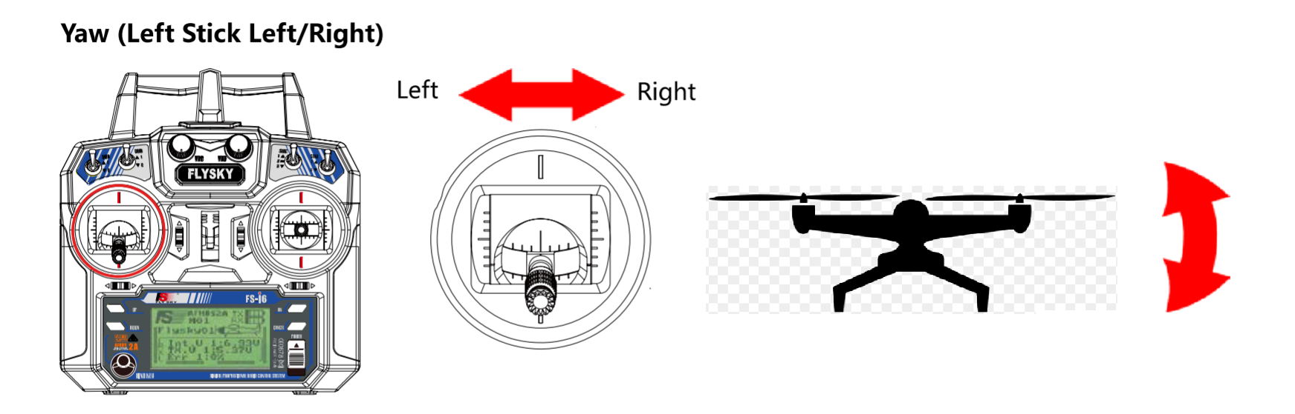
FUNCTION OF EACH STICK

Slide 15
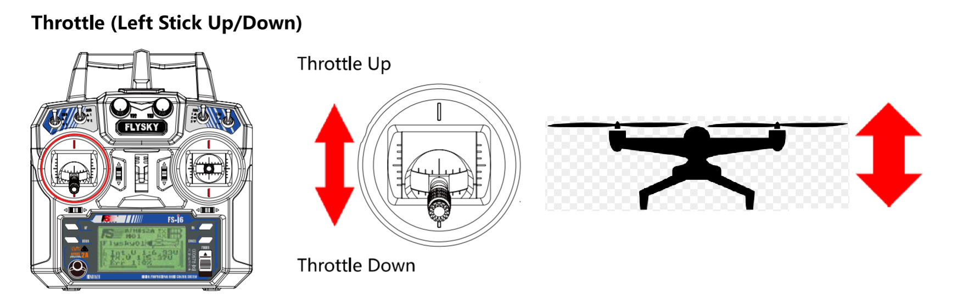
FUNCTION OF EACH STICK

Slide 16
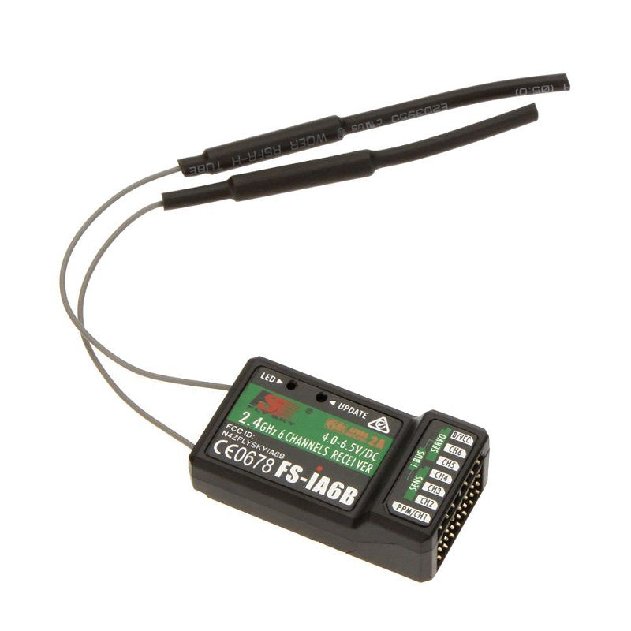
Receiver (Fly sky fs-ia6)
Channels : 6
RF range : 2.408 - 2.475GHz
Bandwidth : 500 KHz
Bands : 135
RF power : Less than 20 dBm
Rx sensitivity : ~105 dBm
Protocol : AFHDS 2A
Modulation type : GFSK
Power input : 4 – 6.5 V DC
Antenna length : 26 mm x 2
Weight : 7g
Size : 40 x 21 x 15 mm
Color : Black

Slide 17
Binding Transmitter and Receiver (Fly sky fs-i6)
A pair of transmitter and receiver are pre-bound while manufacturing.
However, if you are using another transmitter or receiver, follow the below steps :
Connect the supplied bind cable to the B/VCC port the receiver.
Insert power into any other port.
Hold the ‘BIND KEY’ while powering on the transmitter to enter the blind mode.
Remove the power and bind cable from the receiver. Then connect the power cable to the B/VCC port.
Test by giving little throttle, the motor should rotate. If this does not happen, repeat the above process.

Slide 18
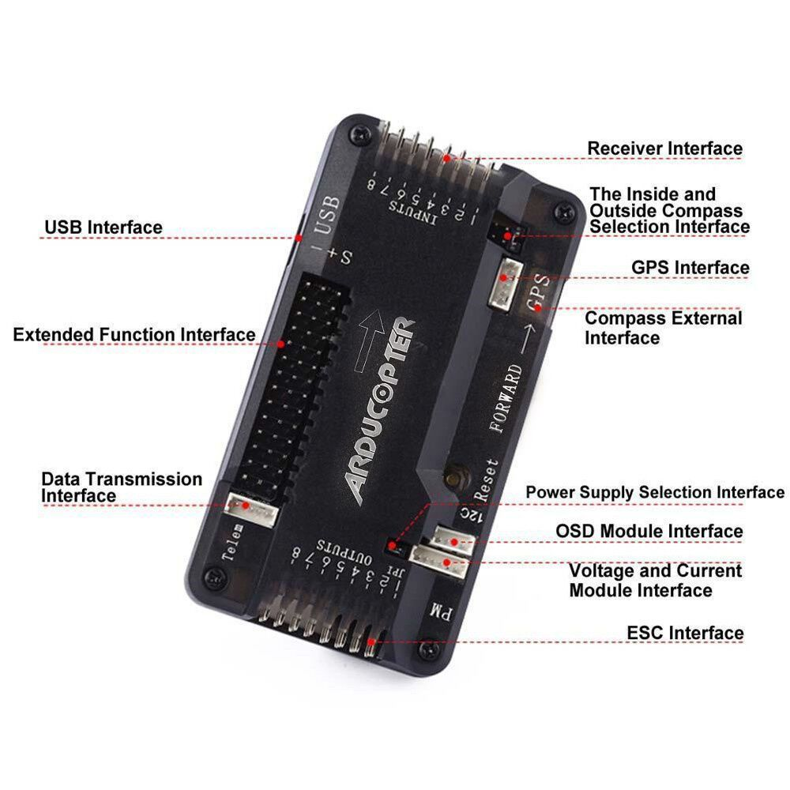
Controller (ArduPilot APM 2.8)
Model | : APM 2.8
Power supply | : LP2985-3.3.
Input Voltage (V) | : 12~16 VDC
Sensors | : 3-Axis Gyrometer
 | Accelerometer
 | High-performance Barometer
Processor | : ATMEGA2560 and ATMEGA32U-2
Dimensions (mm) LxWxH | : 70 x 45 x 15
Weight (gm) | : 82
Shipment Weight | : 0.085 kg
Shipment Dimensions | : 9 × 3 × 2 cm

Slide 19
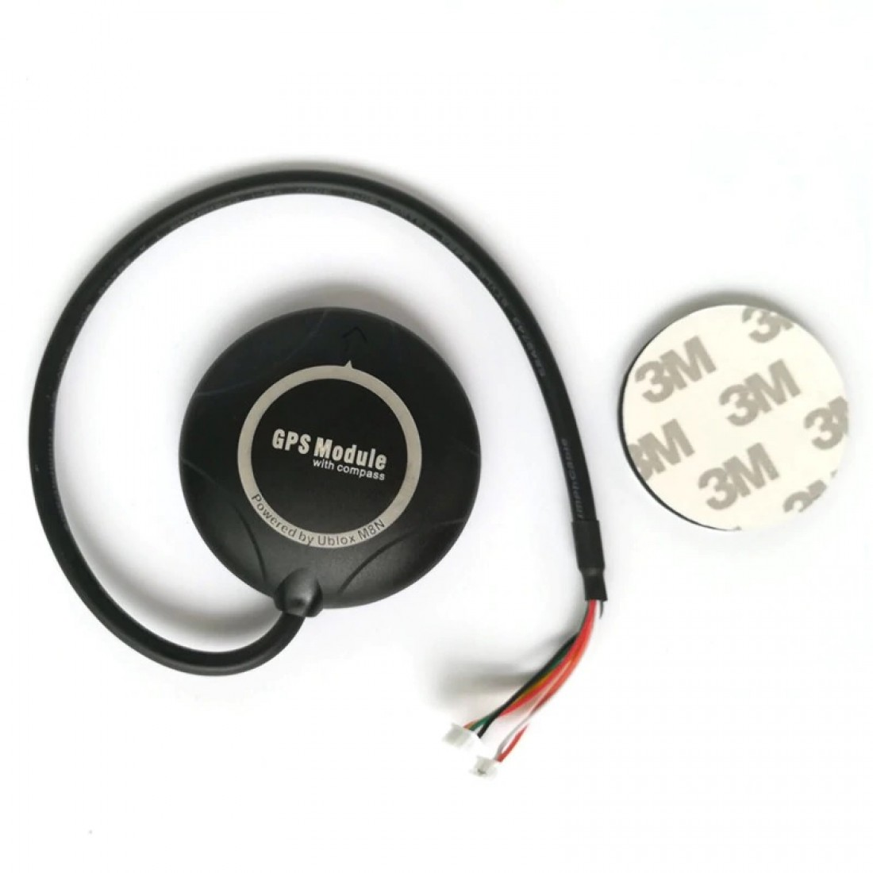
GPS MODULE
Model : FPV Ublox NEO-M8N
Receiver Type : 72-channel Ublox M8 engine.
Main Chip : Ublox NEO-M8N
Sensitivity : Cold starts: –148 dBm. Hot starts: –156 dBm.
Position Accuracy : Autonomous: 2.5 m SBAS: 2.0 m
Acceleration : <4g
Navigation Update Rate : up to 18 HZ.
Operating Temperature Range : -24ºC ~ 84°C
Tracking Sensitivity : –167 dBm.
Capture Time : 0.1s Average
Dimensions (mm) LxWxH : 50 x 12.8 (Dia x W)
Weight (gm) : 28
Cable Length : 30 CM
Supply Voltage (V) : 1.4~3.6

Slide 20
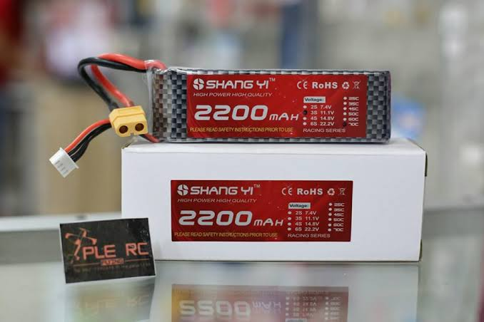
Battery (2200mAh 3S, 11V) (Shang yi B3)
Battery Type: Lithium Polymer 2200mAh 3S 25C
Capacity: 2200 mAh
Number of cells : 3S
Total supply voltage : 11.1V
Size: 24 x 34 x 108mm
Discharge Rate : 25 C
Burst Rate : 50C
Weight : 183g

Slide 21
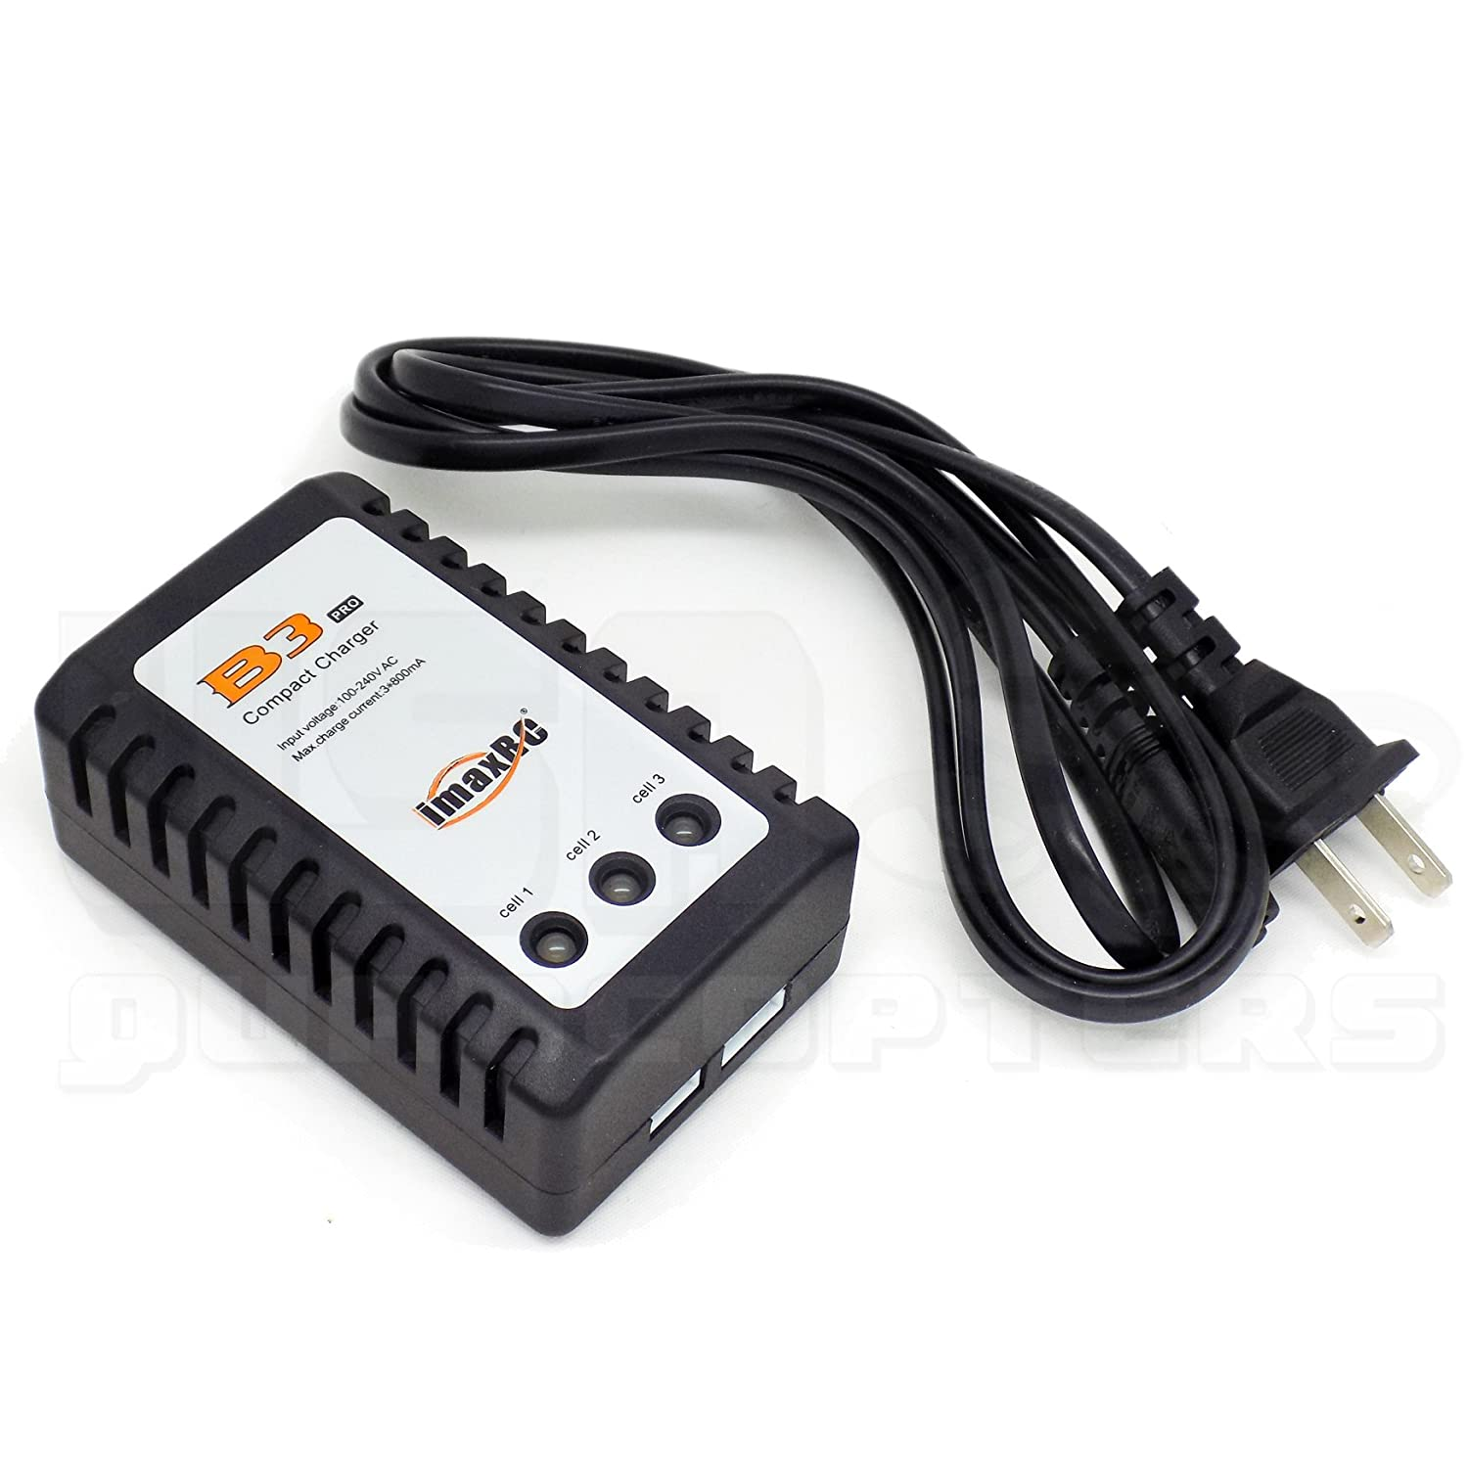
Battery Charger
AC Input : 100~240V, 50~60Hz
Battery Type : Li-Poly
Cell Count : 2~3 Cells
Charge Current : 1.2A Max
Cell Cut Off Voltage : 4.2V 0.02V
Circuit Power : 11W 10%
Dimensions : 88x57x35mm
Weight : 103g
Plug : US 2 Pin Plug

Slide 22
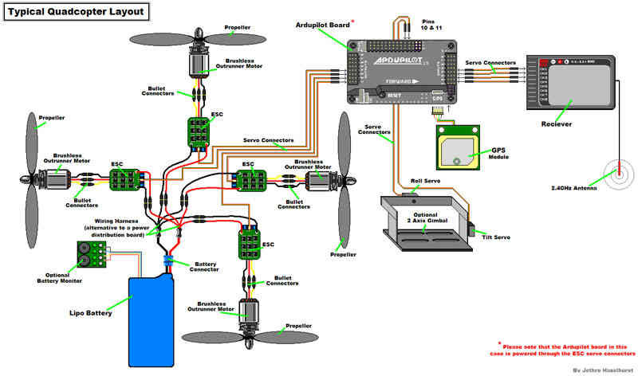
Overall Interconnection Diagram

Slide 23
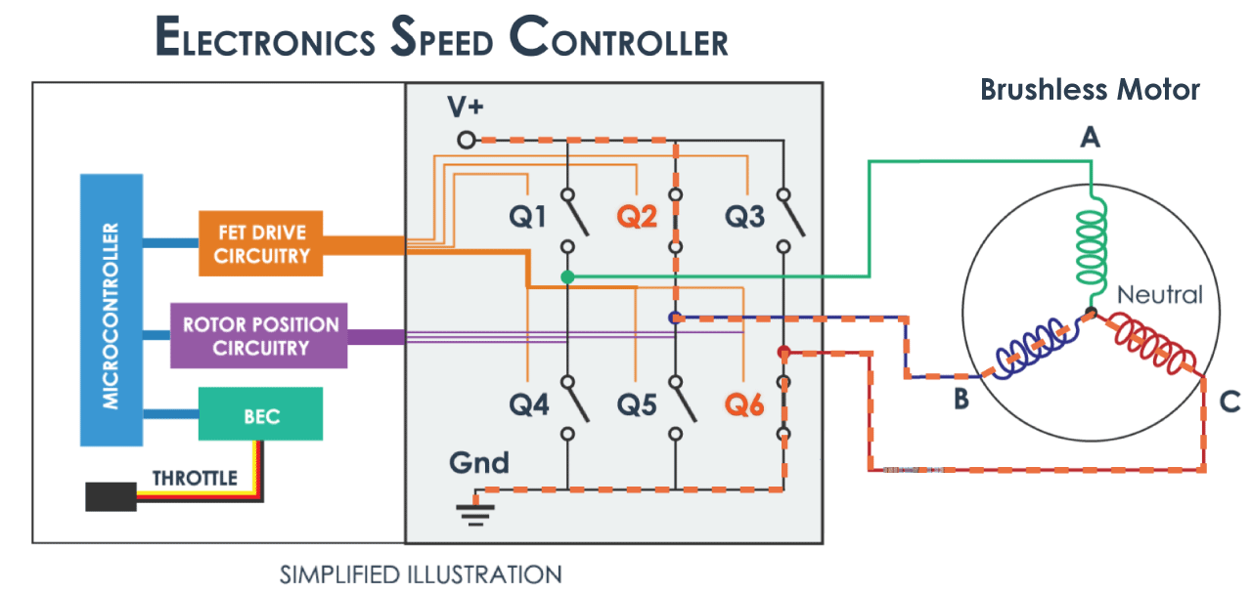
CONNECTION BETWEEN ESC AND MOTOR

Slide 24
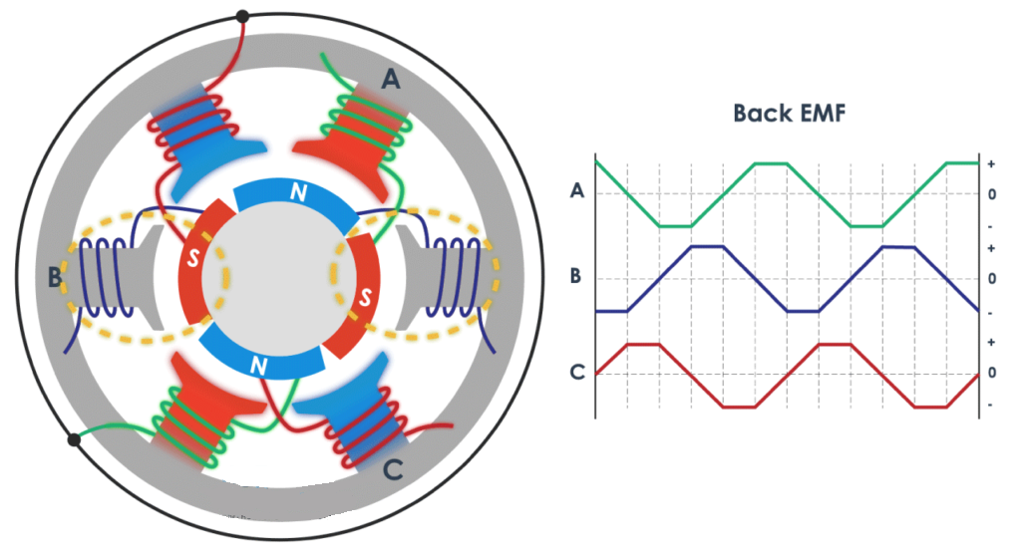
Sensing the back EMF
ESC senses the back EMF from the motor in order to determine the motor position.
Based on the acquired motor position, ESC activates different phases to rotate the motor.

Slide 25
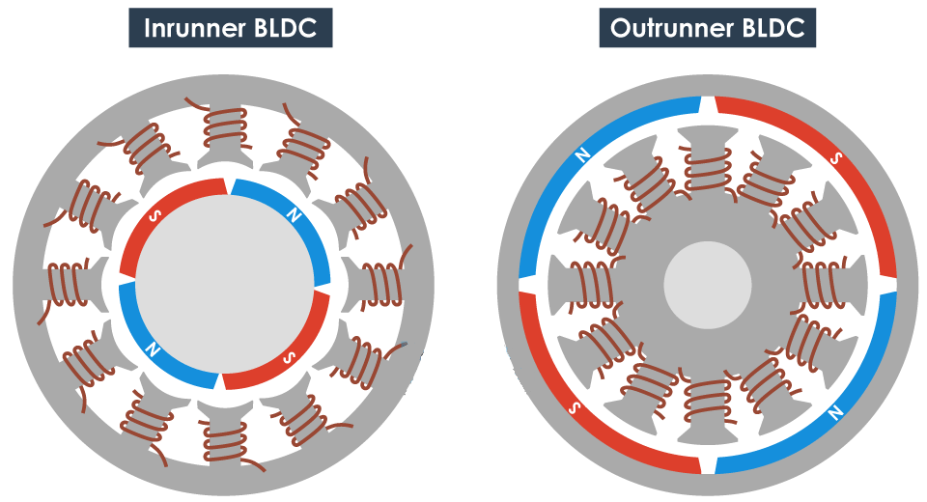

Slide 26
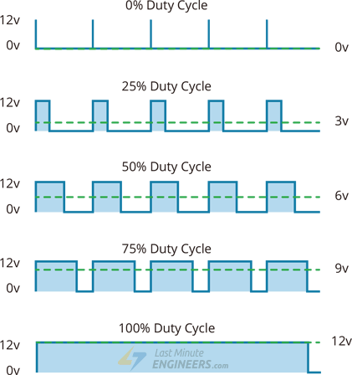
SIGNAL FROM CONTROLLER TO ESC
PWM Signal is sent from the controller to the ESC module in order to control the speed of the motor.
Lesser the Duty cycle of the PWM signal lesser is the RPM of the motor.
Max. RPM achieved at 100% Duty cycle.

Slide 27
Video tutorial for Assembling the drone

Slide 28
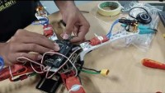

Slide 29
CONFIGURATION OF DRONE

Slide 30
43
Installing Mission planner on UBUNTU 20.04
STEP 1: Install Mono
sudo apt install mono-runtime libmono-system-windows-forms4.0-cil libmono-system-core4.0-
cil libmono-winforms2.0-cil libmono-corlib2.0-cil libmono-system-management4.0-cil libmono- system-xml-linq4.0-cil
Or full Mono: (In case upper command does not work use this one.)
sudo apt install mono-complete
STEP 2: Download Mission planner
Download MissionPlanner.zip using the below steps:
Get the latest zipped version of Mission planner here: https://firmware.ardupilot.org/Tools/MissionPlanner/MissionPlanner-latest.zip
Unzip in the appropriate directory
Open terminal, go into the directory where you unzipped your mission planner.
Run Mission planner using the command:
mono MissionPlanner.exe.
You can debug Mission Planner on Mono with the command:
MONO_LOG_LEVEL=debug mono MissionPlanner.exe

Slide 31
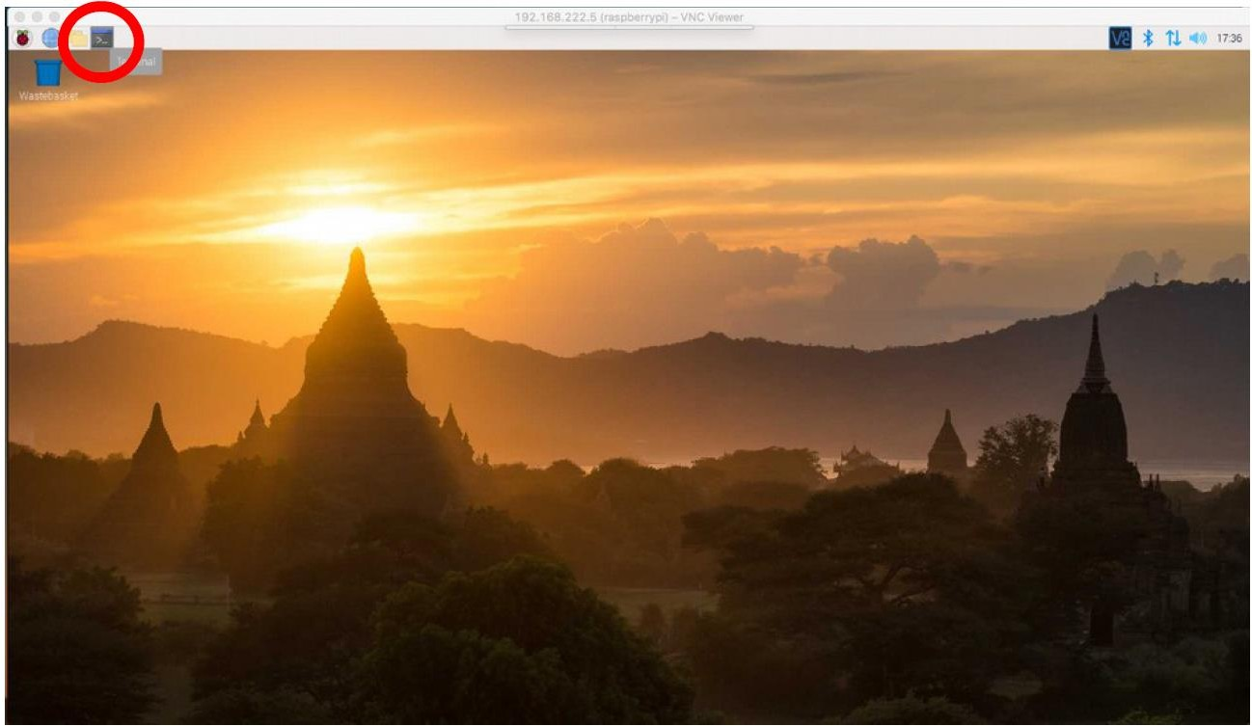
3
Installing Mission planner on Raspberry pi OS
STEP 1: Install Mono
First, open the Terminal by clicking the icon in the top left corner.

Slide 32
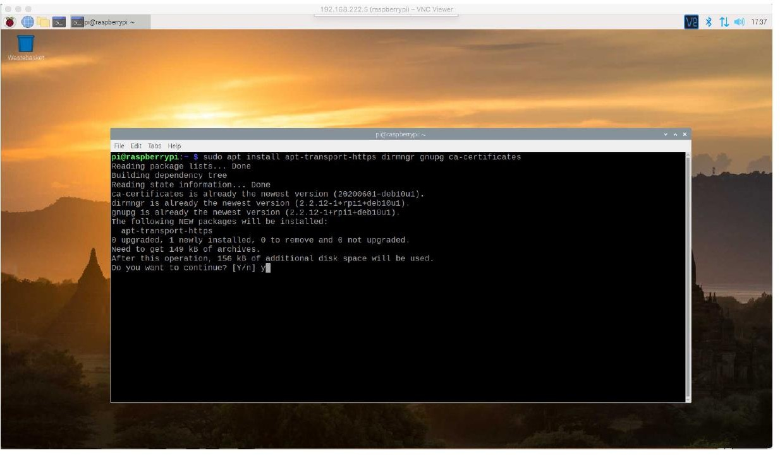
4
Command 1: “sudo apt install apt-transport-https dirmngr gnupg ca-certificates”

Slide 33
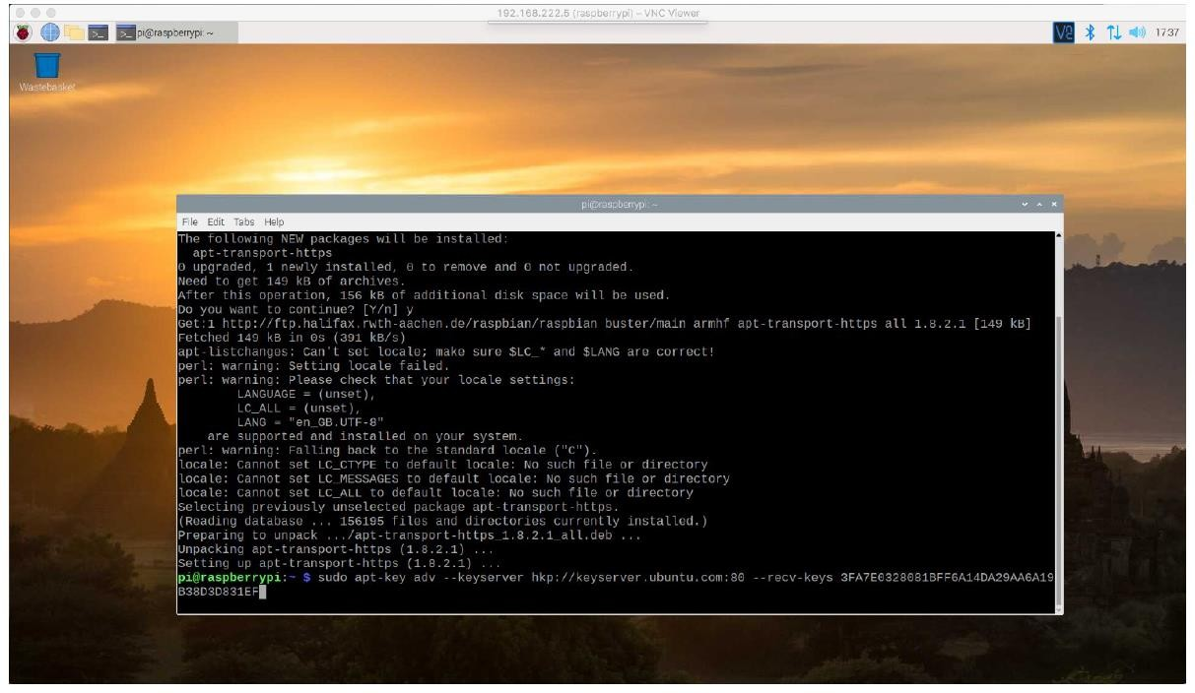
5
Command 2:” sudo apt-key adv --keyserver hkp://keyserver.ubuntu.com:80 --recv-keys 3FA7E0328081BFF6A14DA29AA6A19B38D3D831EF”

Slide 34
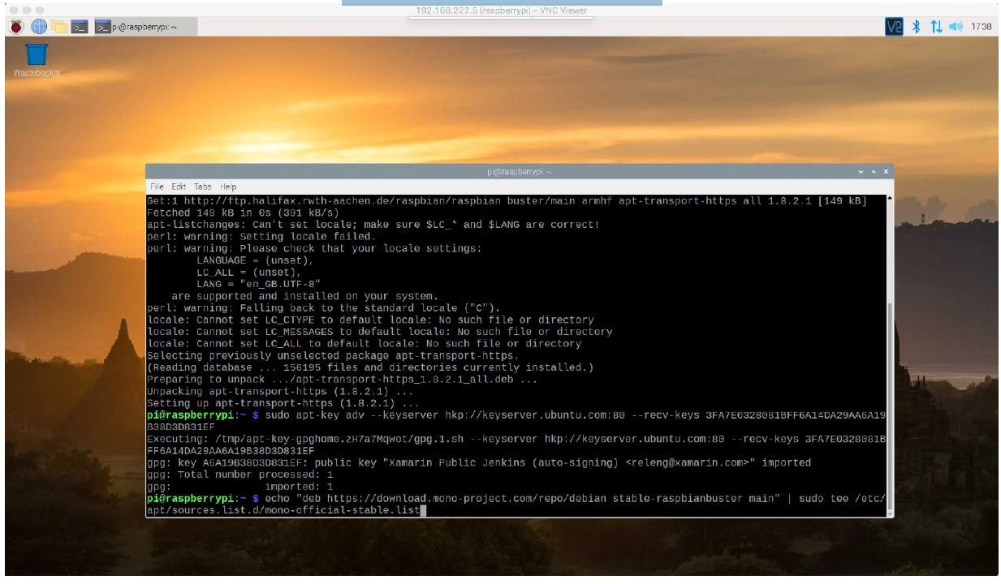
6
Command 3: echo "deb https://download.mono-project.com/repo/debian stable-raspbianbuster main" | sudo tee
/etc/apt/sources.list.d/monoofficial-stable.list (Enter both commands as one line!)

Slide 35
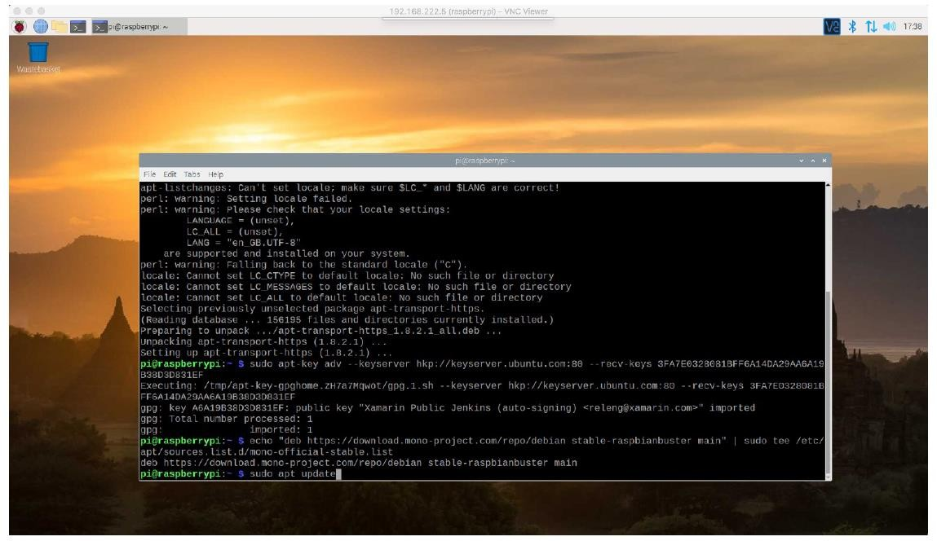
7
Command 4: sudo apt update
After this, the terminal should tell you “all packages are up to date”. If this is not the case, please enter: “sudo apt upgrade”.

Slide 36
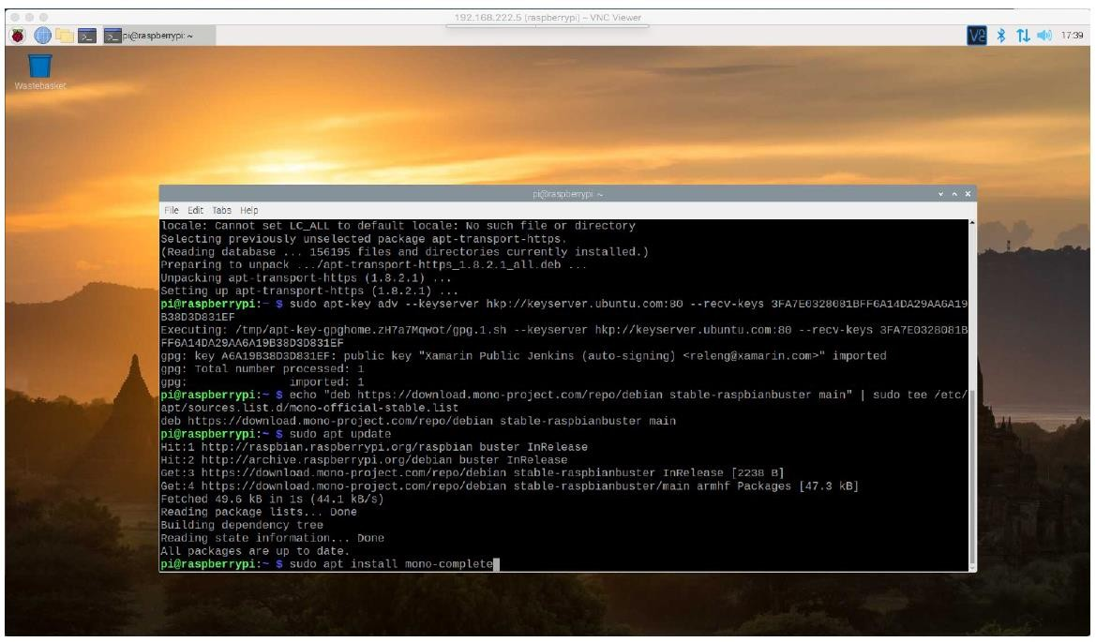
8
Command 5: sudo apt install mono-complete
Note: This step will download 300MB and take some minutes.

Slide 37
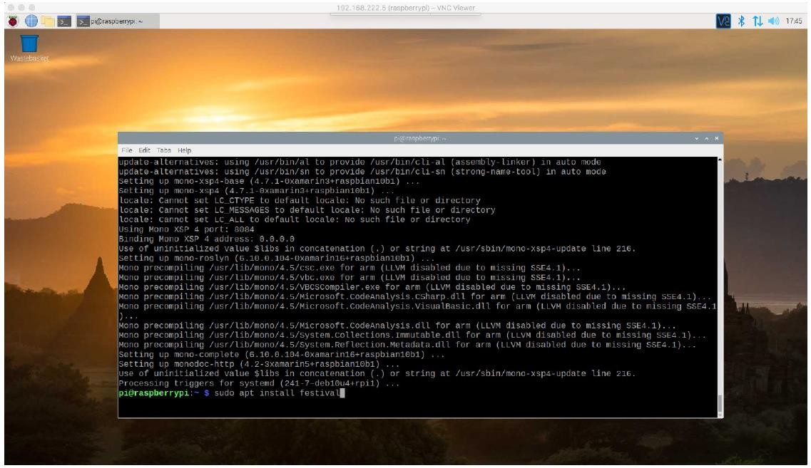
9
When mono is finished, we need to install “Festival”. This is needed to give Mission Planner a voice.
Command 6: sudo apt install festival

Slide 38
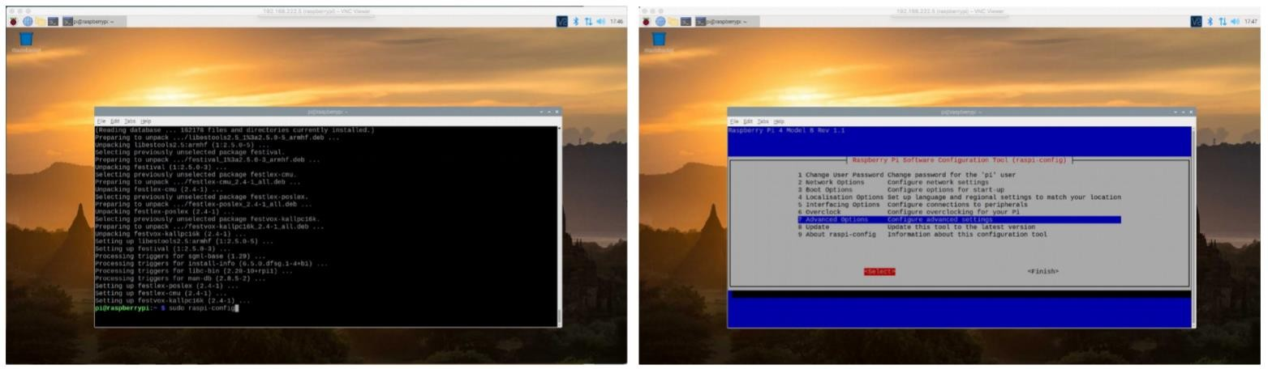
10
STEP 2: Deactivate OpenGL
Run command: sudo raspi-config
Select “Advanced options”

Slide 39
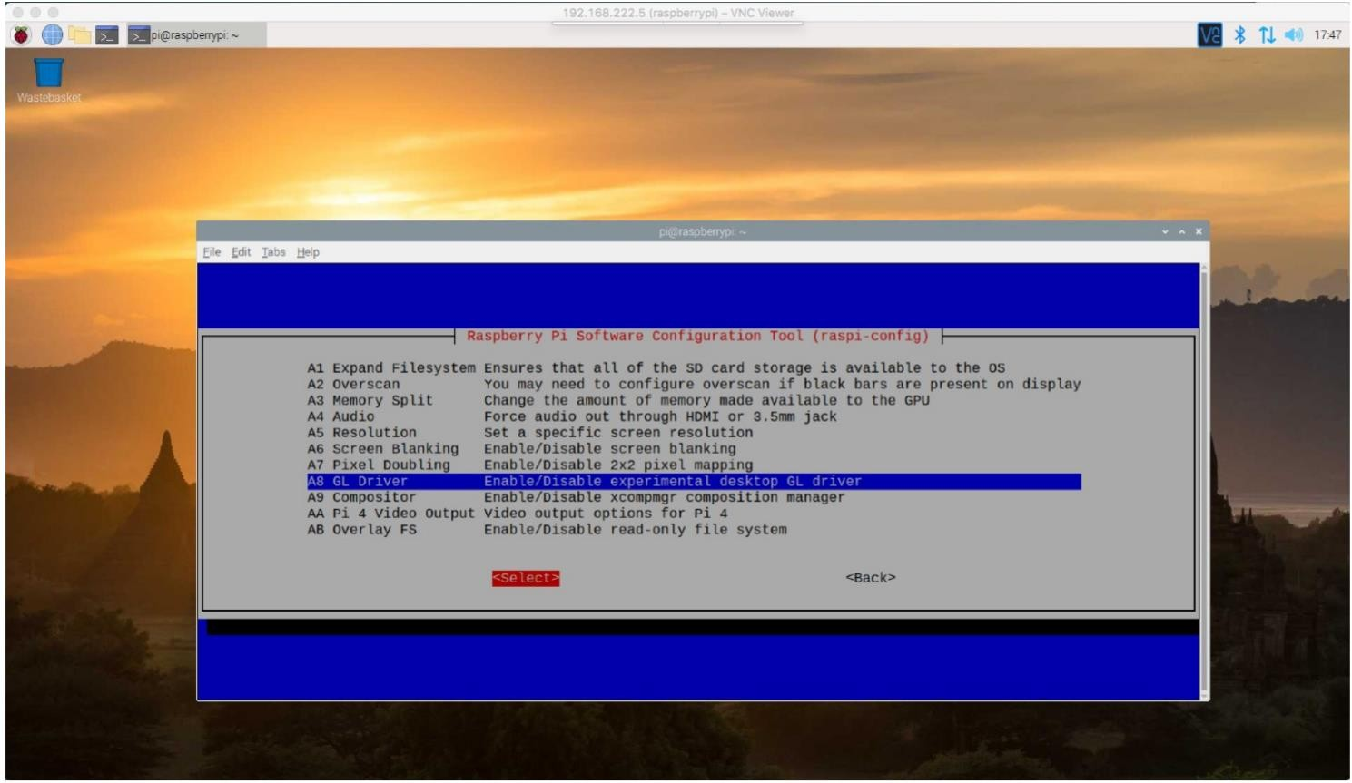
11
Select “GL Driver”

Slide 40
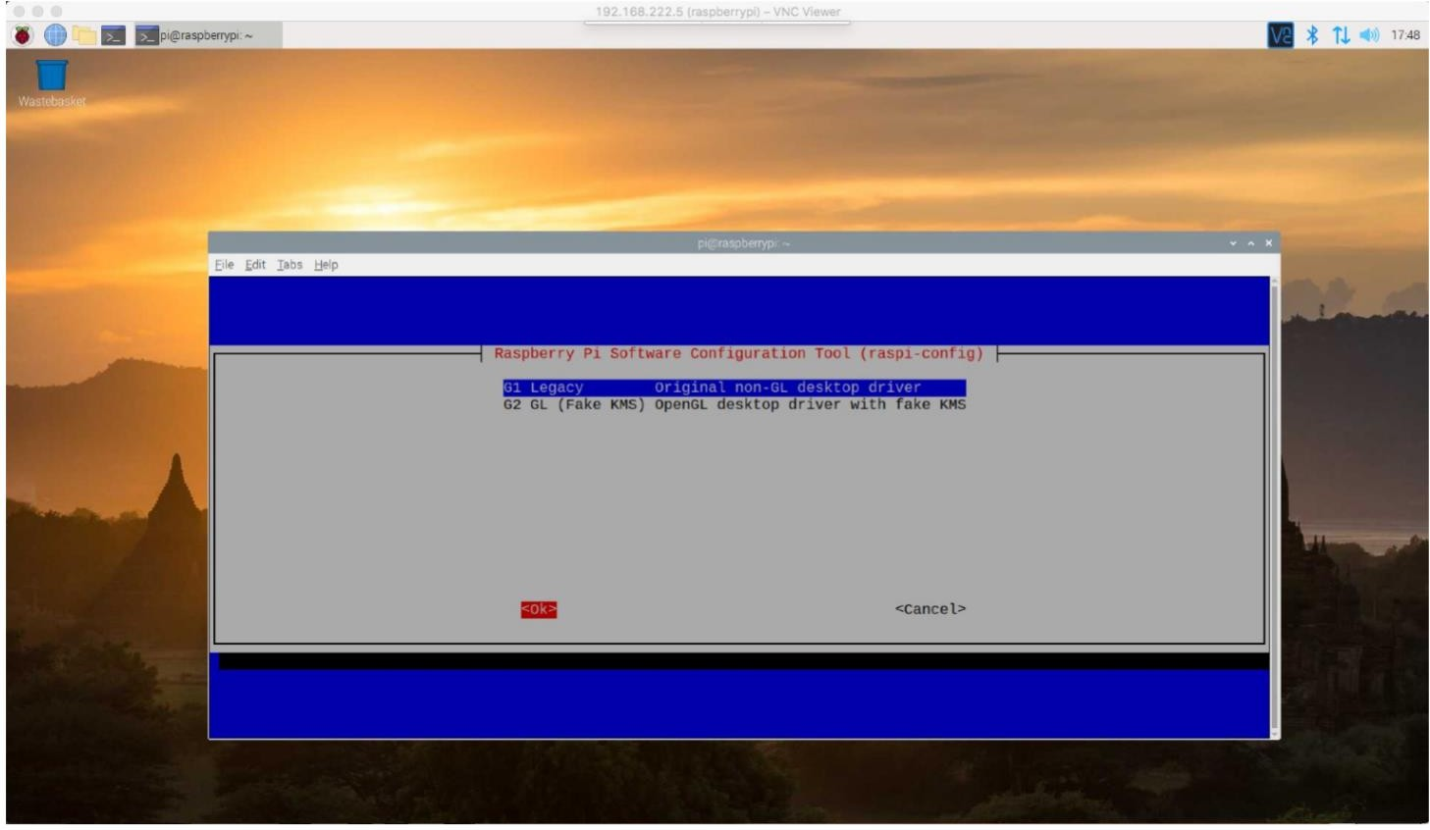
12
Choose “G1 Legacy”

Slide 41
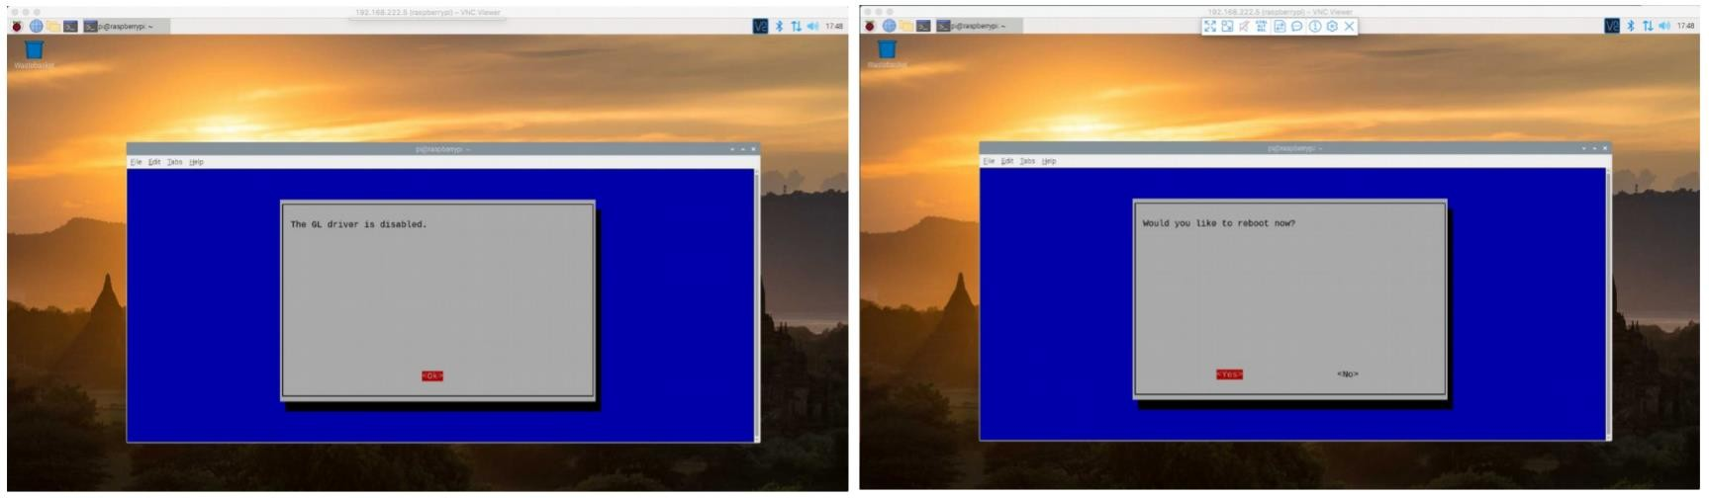
13
It should say “GL driver is disabled”. Click “OK”
Select the “Finish” option and select “Reboot” to reboot the system and apply changes.

Slide 42
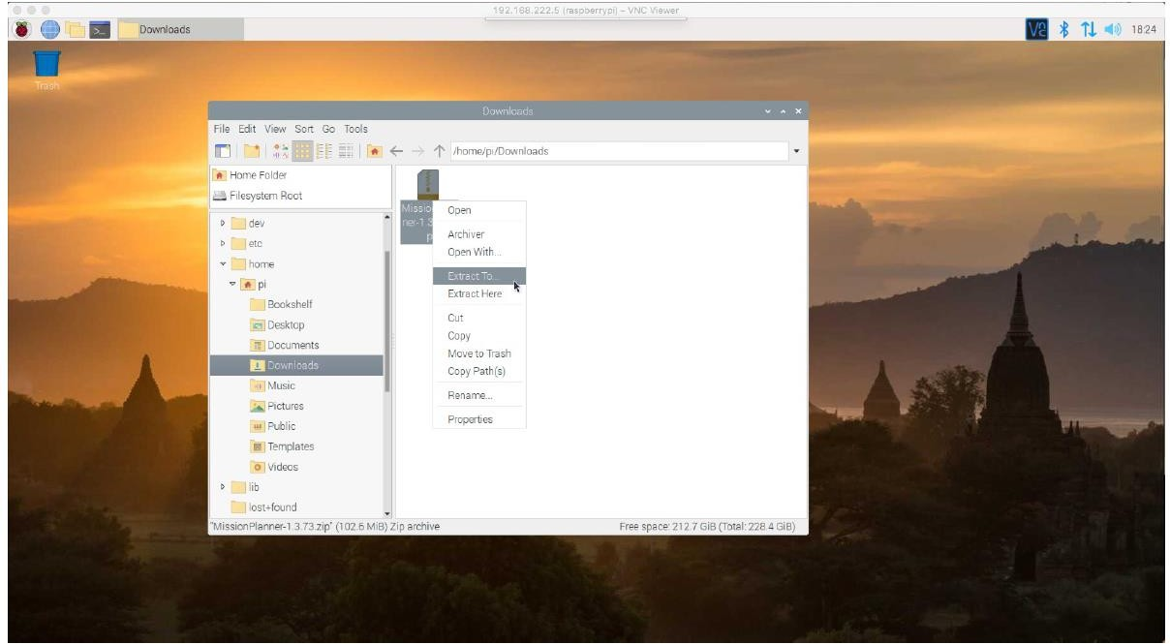
14
STEP 3: Download Mission planner
Download MissionPlanner.zip using the below steps:
Open Chromium web browser.
Go to https://firmware.ardupilot.org/Tools/MissionPlanner/
Download the latest version of Mission Planner. (1.3.74)
Note: download the .zip file.
Also, on the top left, you'll find your File Manager. Go to “home/pi/Downloads”.
Right-click on the file → extract to.

Slide 43
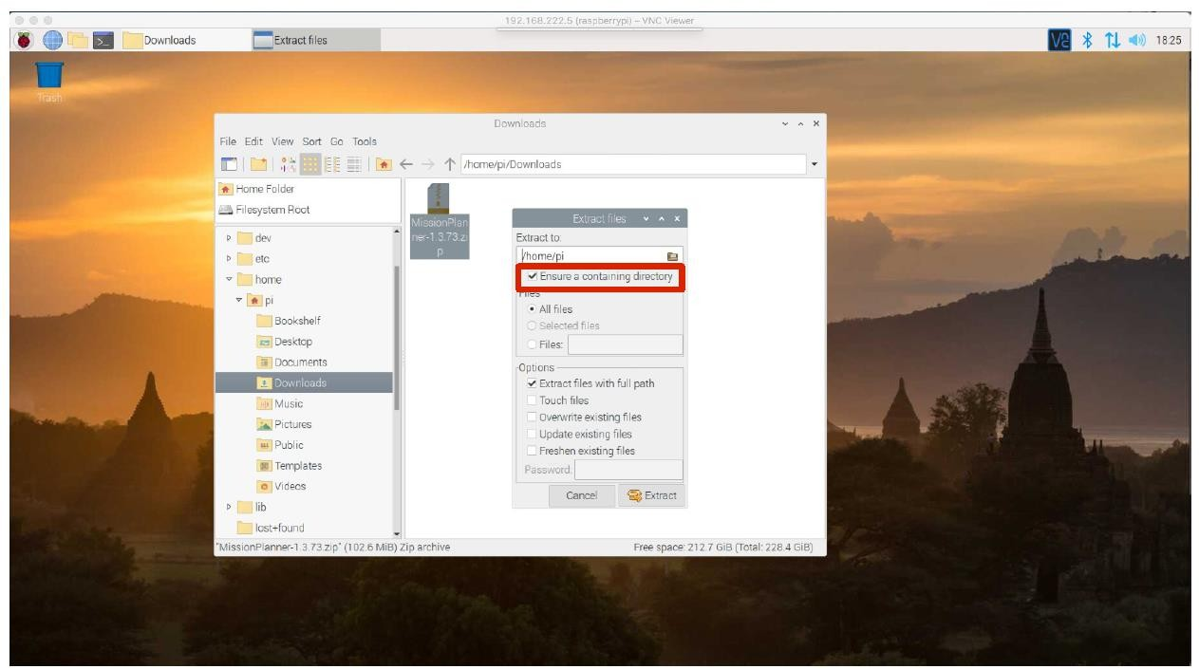
15
Extract it at any desire location. However, you'll need to enter the path later to create a desktop icon for easy access.
I extracted it straight to “home/pi/” where it will create its own directory (be sure to tick “ensure a containing directory”)

Slide 44
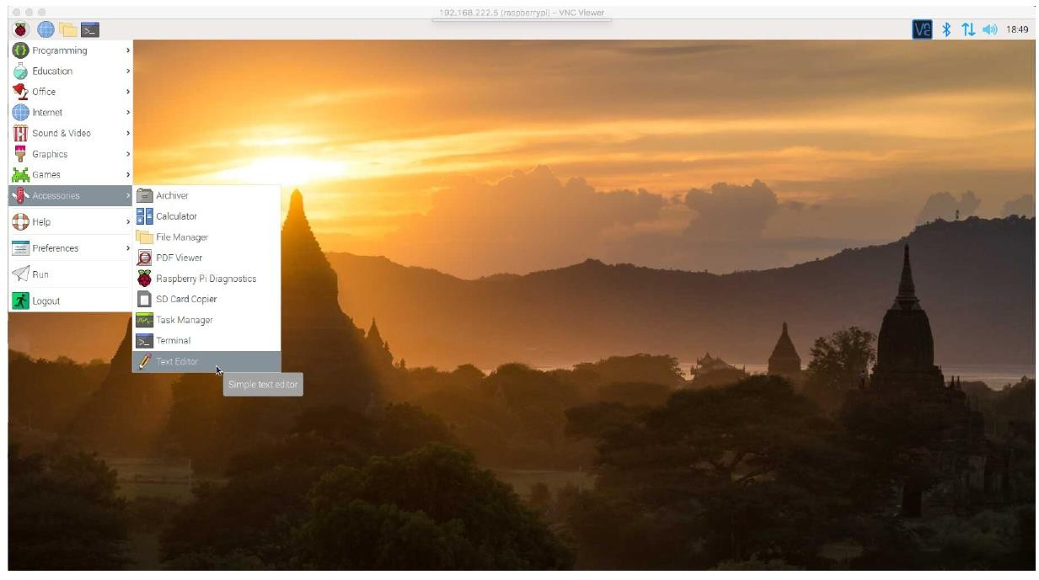
16
Follow these steps to create a desktop icon:
Have a look under the Raspberry for Text Editor.

Slide 45
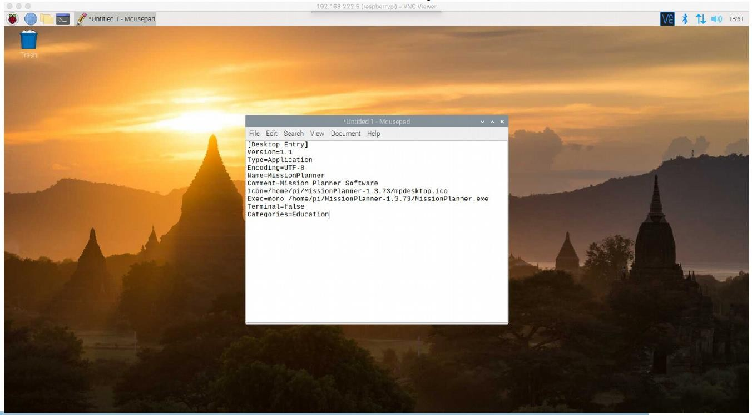
17
We will copy the following lines into the Text editor and save that as “MissionPlanner.desktop” straight on our desktop. (Note: Change the path for the Icon and the Exec to the path of extraction. However, “=mono” is required) [Desktop Entry]
Version=1.1 Type=Application Encoding=UTF-8 Name=MissionPlanner
Comment=Mission Planner Software Icon=/home/pi/MissionPlanner-1.3.74/mpdesktop.ico
Exec=mono /home/pi/MissionPlanner-1.3.74/MissionPlanner.exe Terminal=false
Categories=Education

Slide 46
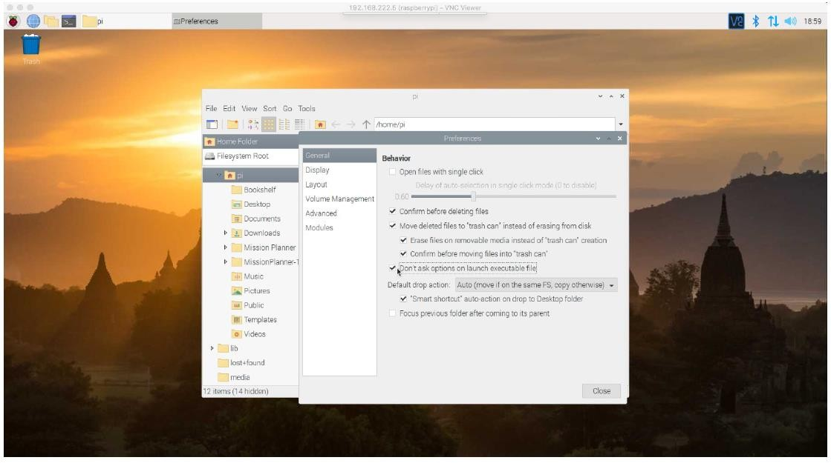
18
When you click on your new desktop icon, your Pi will prompt you with some rather annoying choices. We will now remove them.
Inside your “File Manager” top menu → edit → preferences → general.
Toggle the box “don't ask options on launch executable files”.

Slide 47
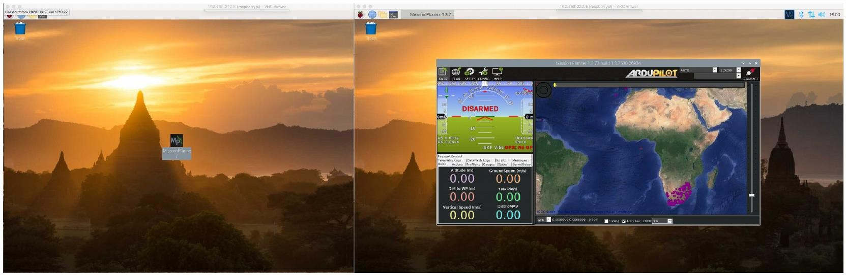
19
The Download and install process is now completed.

Slide 48
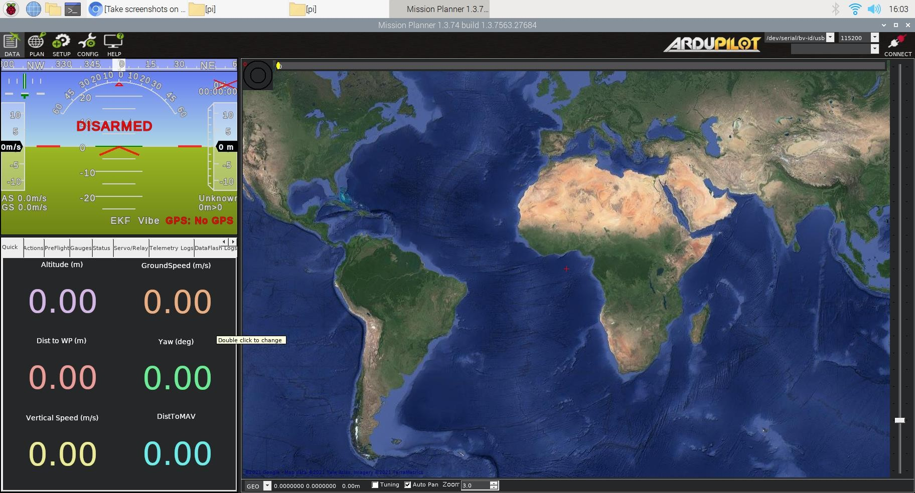
20
Calibration of drone using mission planner on Raspberry pi OS
STEP 1: Getting started.
Connect the Raspberry pi board to APM 2.8 using a Type-B USB cable.
Open mission planner using the desktop icon created in the previous section.

Slide 49
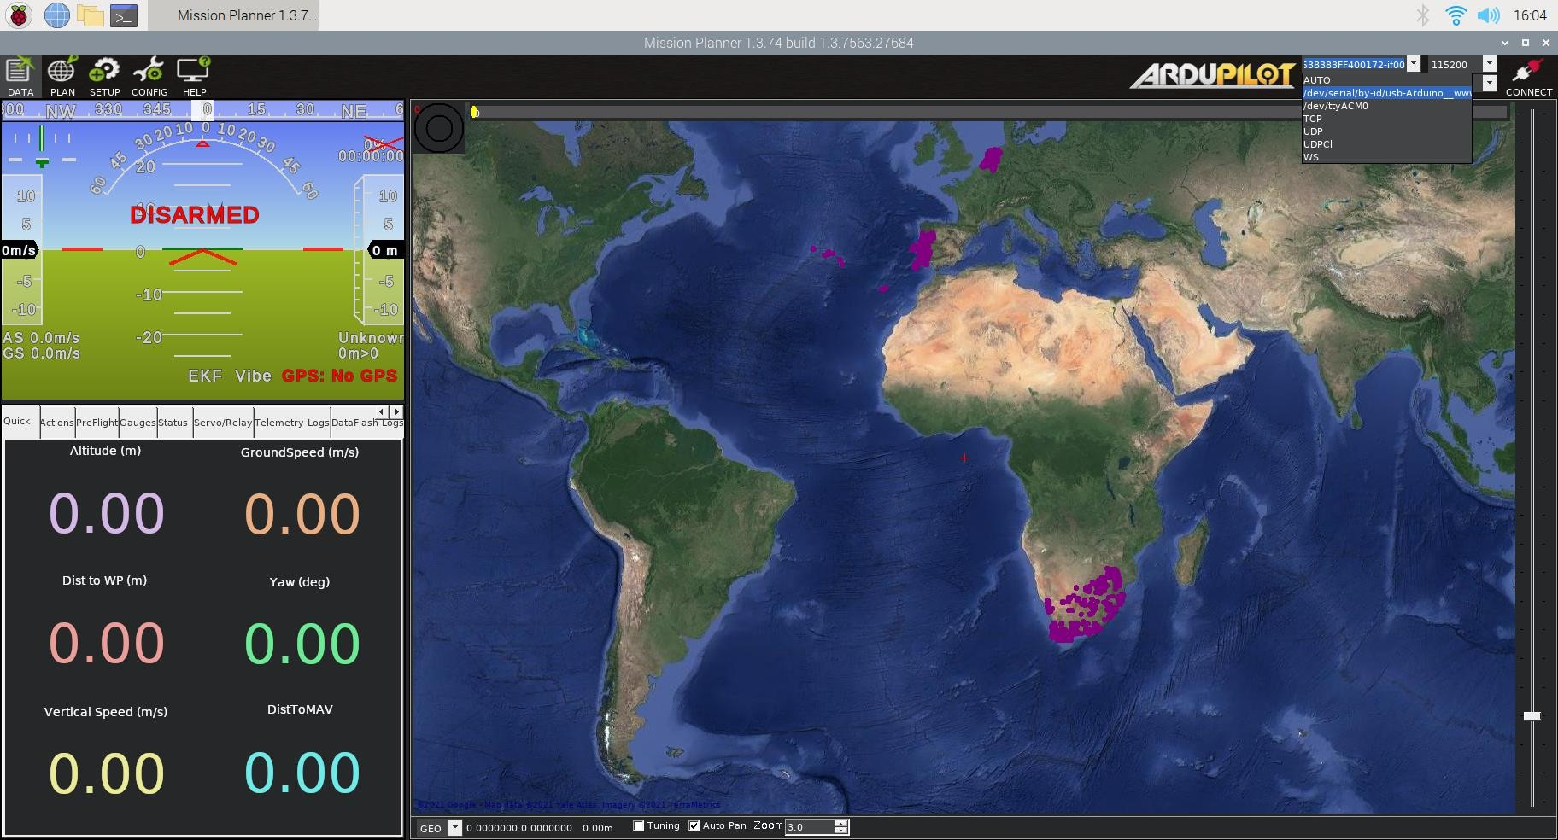
21
Select “/dev/serial/by-id/usb-Arduino_ww….” port from the dropdown menu in the top right corner.

Slide 50

22
Open the “Setup” menu from the top left corner, select “Firmware legacy”.

Slide 51
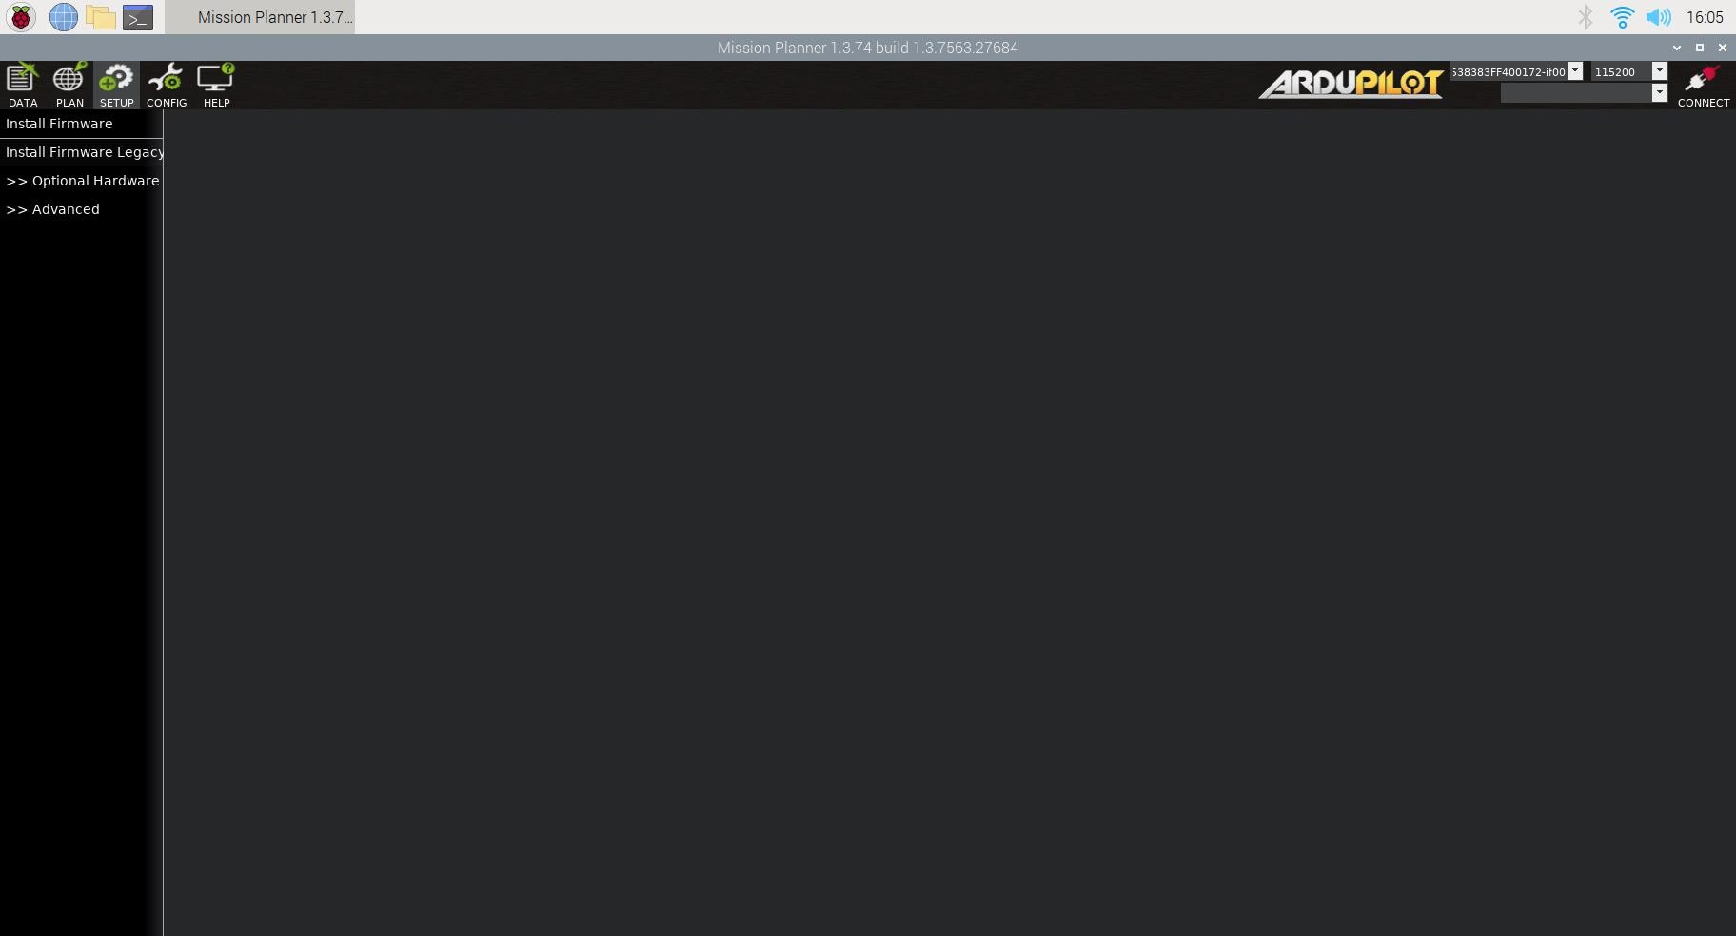
23
Select “Firmware Legacy”.

Slide 52
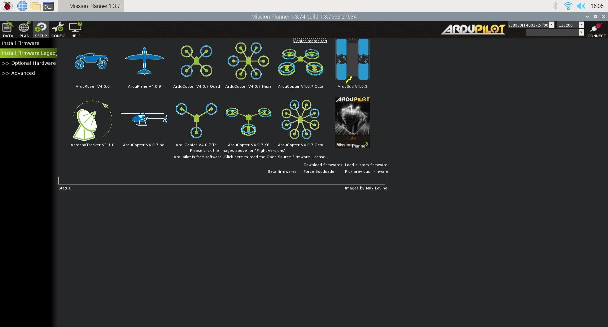
24
Select the appropriate icon that matches your frame (i.e., Quad)

Slide 53
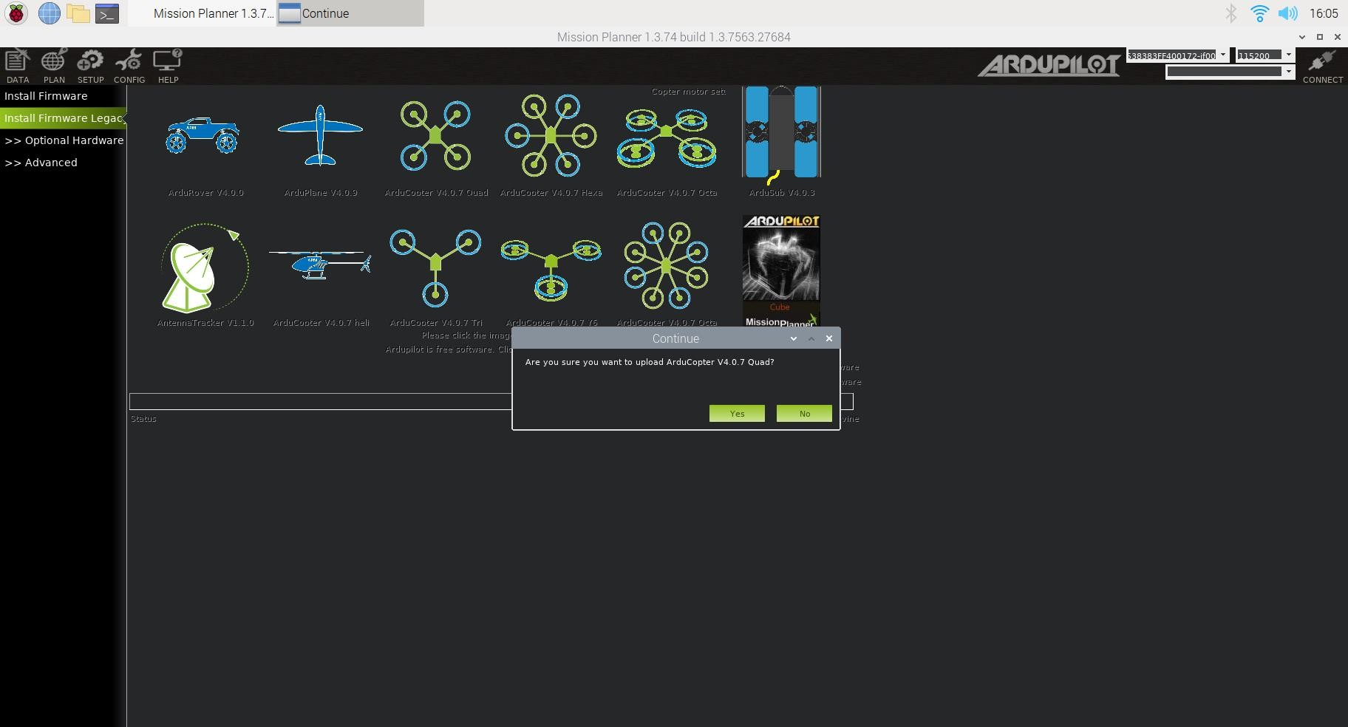
25
Answer Yes when it asks you “Are you sure?”.

Slide 54
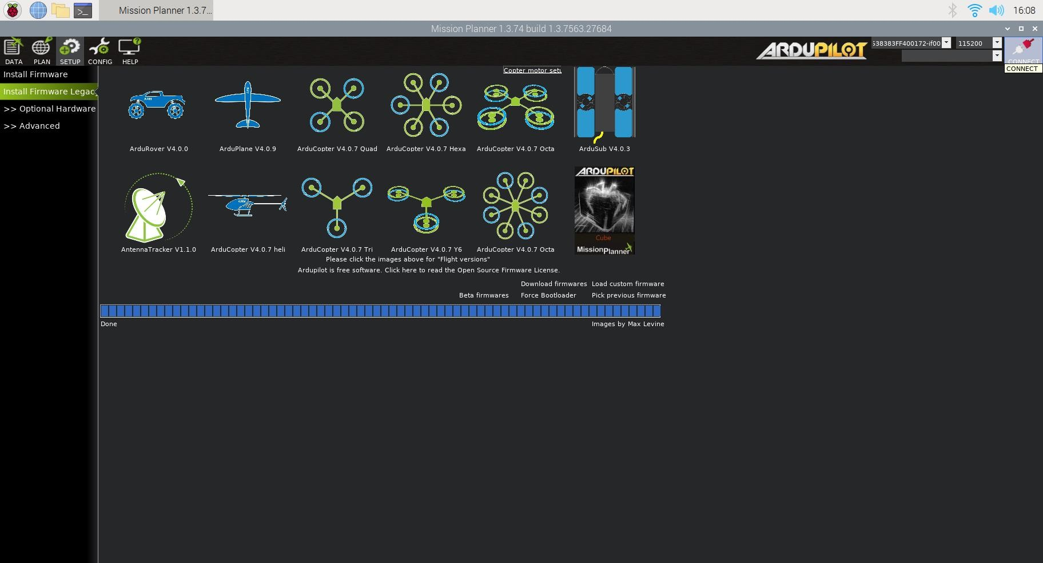
26
If all goes well you will see some status appear on the bottom right including the words, “erase…”, “program…”, “verify...” and “Upload Done”. The firmware has been successfully uploaded to the board.
It usually takes a few seconds for the bootloader to exit and enter the main code after programming or a power-up.
Press CONNECT.

Slide 55
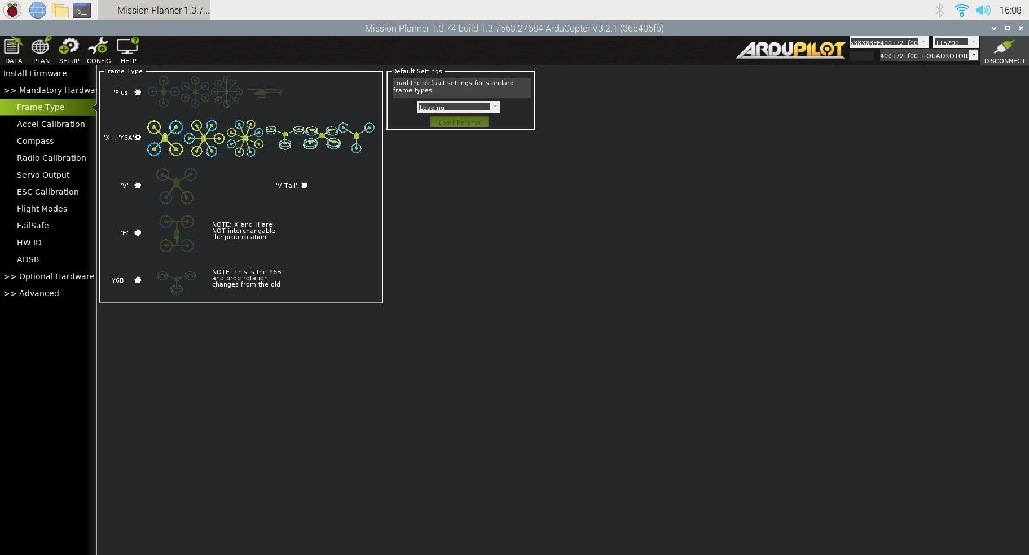
27
STEP 2: Selecting Frame Type
Under Setup | Mandatory Hardware.
Select Frame type from the left-side menu and then choose “ ‘X’ . ‘Y6A’ ”.

Slide 56
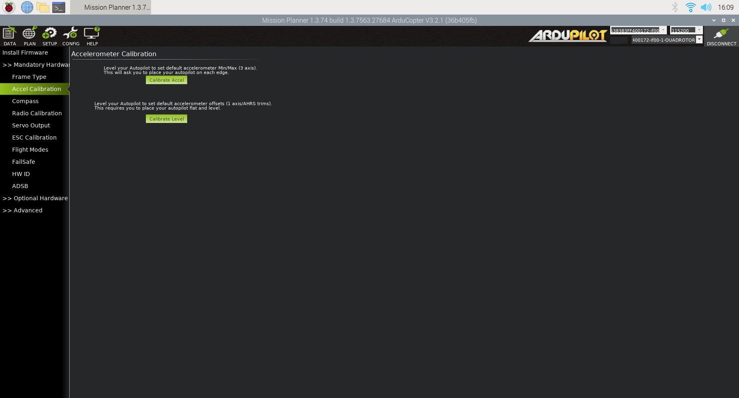
28
STEP 3: Calibration of Accelerometer
Under Setup | Mandatory Hardware.
Select Accel Calibration from the left-side menu.

Slide 57
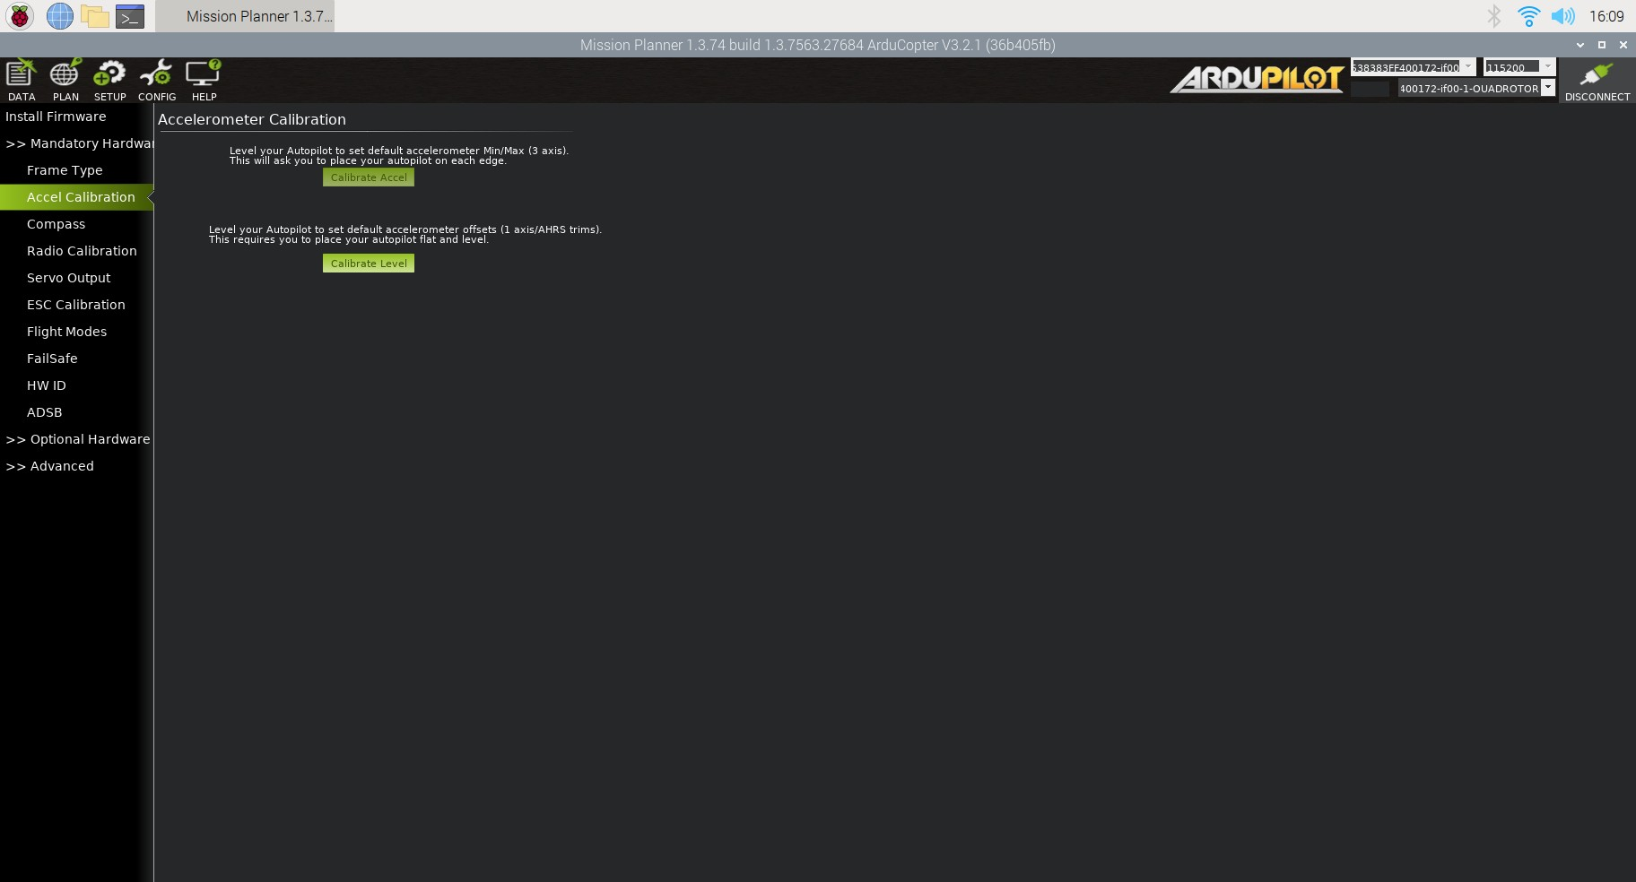
29
Click Calibrate Accel to start the calibration.

Slide 58

30
Mission Planner will prompt you to place the vehicle in each calibration position.
Press any key to indicate that the autopilot is in position and then proceed to the next orientation.
The calibration positions are level, on the right side, left side, nose down, nose up, and on its back.
Proceed through the required positions, using the Click when Done button after each position is reached.
When you have completed the calibration process, Mission Planner will display “Calibration Successful!”

Slide 59
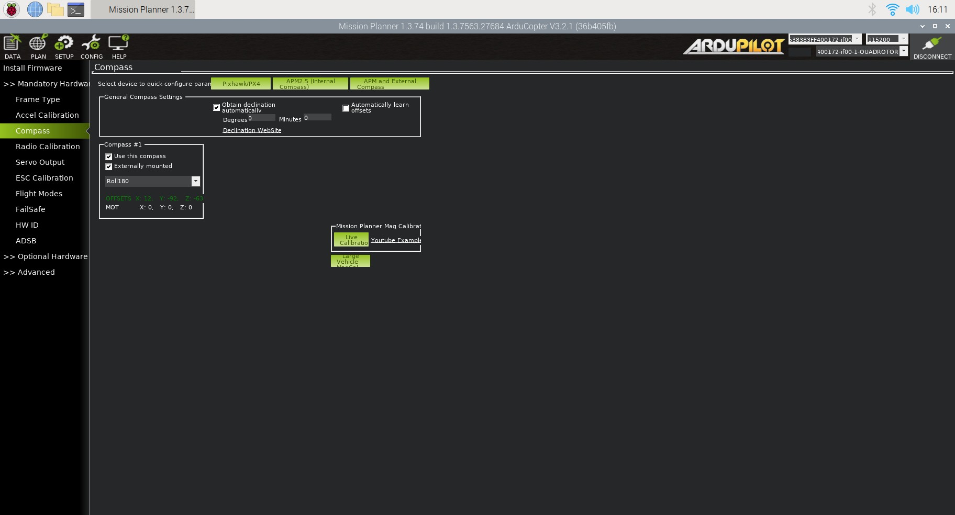
31
STEP 4: Calibration of Compass
Under SETUP| Mandatory Hardware select Compass.

Slide 60
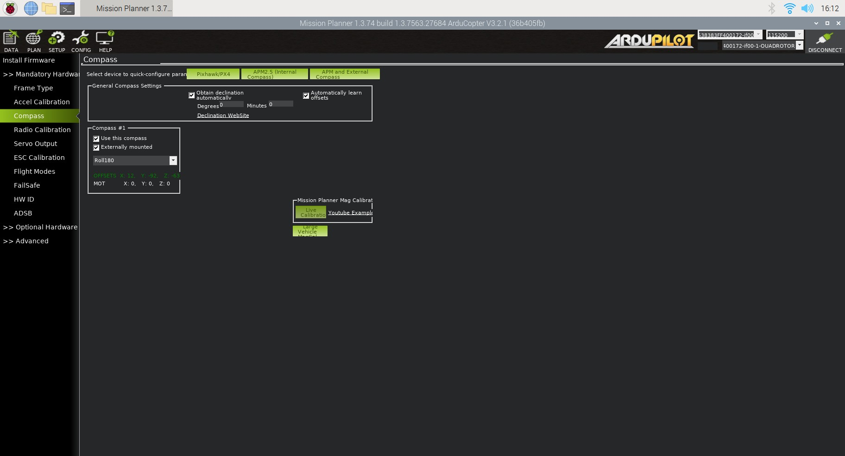
32
Click on “Live Calibration”.

Slide 61

33
Rotate the Controller in all directions and make sure all the white spots are interconnected.

Slide 62

34
Compass offsets will be recorded. Press OK to save the calibrated offsets.

Slide 63

35
After clicking on OK, the following screen appears showing the calibrated offset in green color.

Slide 64
36
STEP 5: Calibration of Radio
Ensure the battery is disconnected (this is important because it is possible to accidentally arm the vehicle during the RC calibration process)
Ensure the RC receiver is connected to the autopilot.
Turn on your RC transmitter and if it has “trim tabs” ensure they are in the middle.
Connect the autopilot to the PC using a USB cable.
On the Mission Planner press the “Connect” button and open Mission Planner’s SETUP | Mandatory Hardware | Radio Calibration screen.

Slide 65

37
Some green bars should appear showing the ArduPilot is receiving input from the Transmitter/Receiver.
If no bars appear check the receiver’s LED:
No lights may indicate that it is incorrectly wired to the autopilot. Look for connectors that may have been inserted upside down.
A Red or flashing LED may indicate that your RC transmitter/receiver needs to be bound. See the manual that came with your RC equipment for instructions.

Slide 66

38
Click on “Radio Calibration”
Press “OK”, when prompted to check the radio control equipment, is on, the battery is not connected, and propellers are not attached.

Slide 67

39
Move the transmitter’s control sticks, knobs and switches to their limits. Red lines will appear across the calibration bars to show
minimum and maximum values seen so far. Select Click when Done.

Slide 68

40
A window will appear with the prompt, “Ensure all your sticks are centered and the throttle is down and click ok to continue”. Move the throttle to zero and press “OK”.
Mission Planner will show a summary of the calibration data. Normal values are around 1100 for minimums and 1900 for maximums.

Slide 69

41
STEP 6: Calibration of ESC (Electronic speed controller)
Connect the ESC to be calibrated to the channel-3 of the receiver.
Power ON the transmitter.
Make the Throttle knob to its max position.
Provide the power supply to the controller by connecting the battery.

Slide 70

42
Now, Bring the Throttle knob position from max to min, you will hear 2 beeps sound which indicates the ESC under calibration is now calibrated.
Repeat these steps for other ESCs.

